Slide 1
Python programming workshop
Dr. Emily Johnson

Slide 2
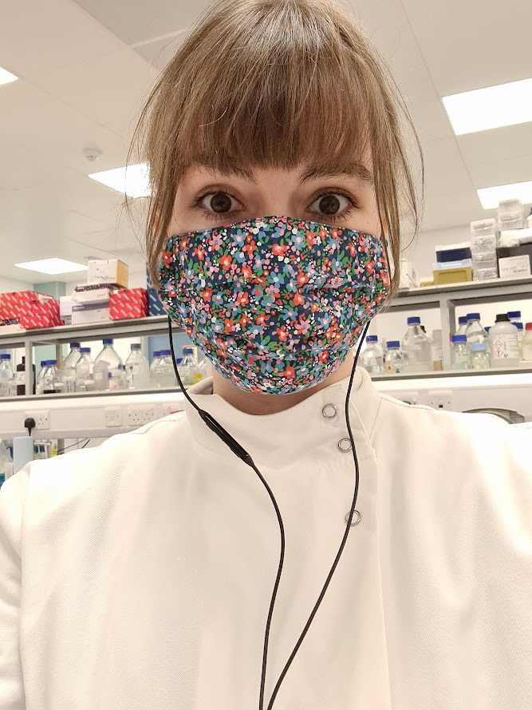
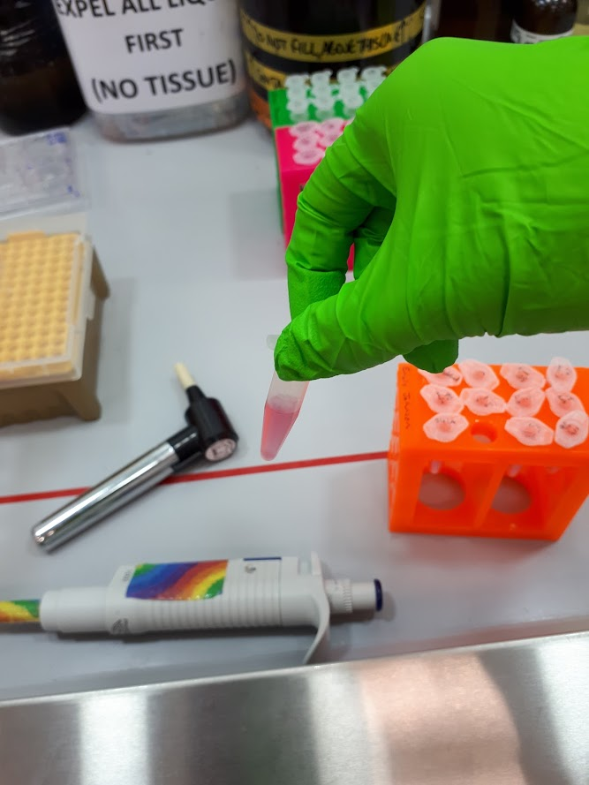
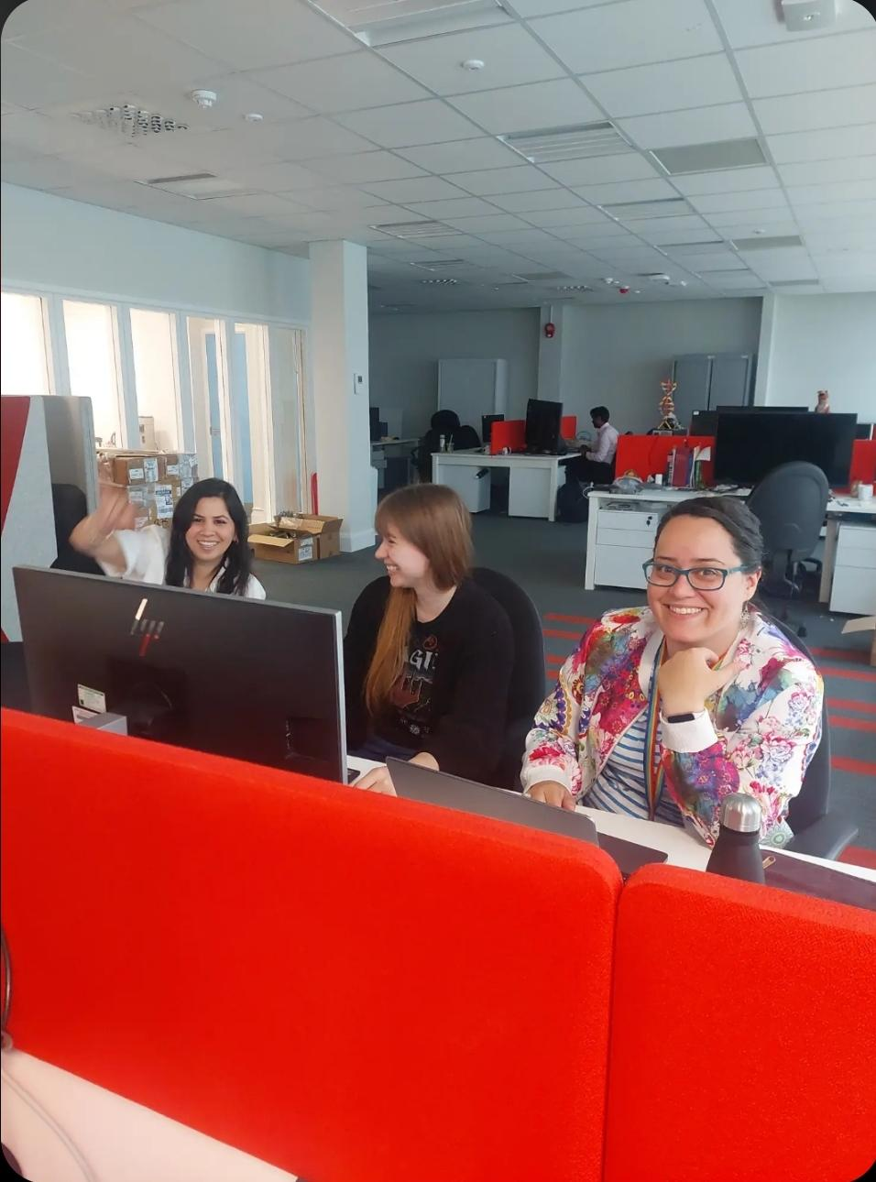
Who am I?
Notes:
/who are we slide that can be modified depending on who comes with me

Slide 3
Purpose of today
To teach you a little bit about ageing and how long animals can live for
To give you an introduction to Python
Note:
These activities are still under active development! You will be the first group we run them with!

Slide 4
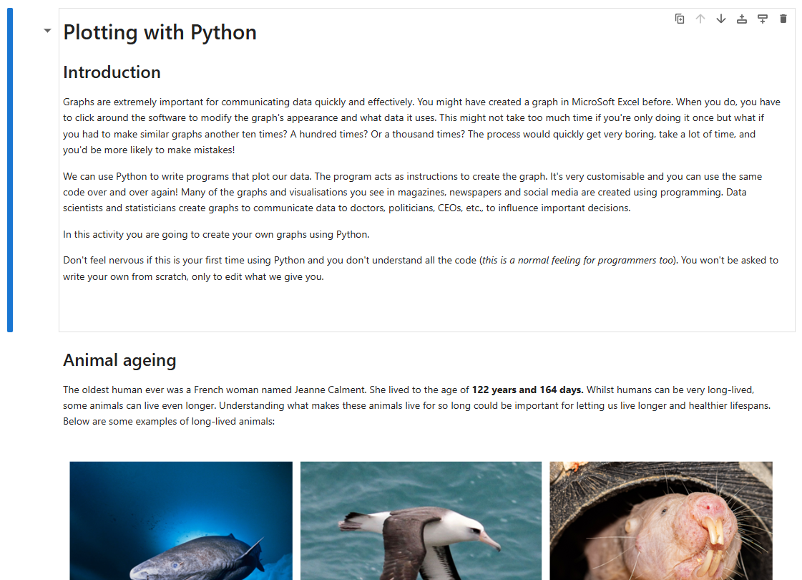
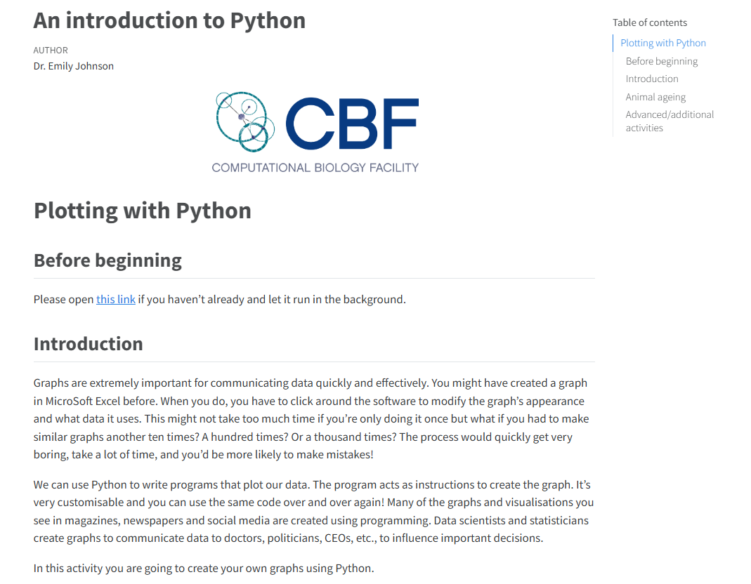
The activity
Type this into your browser: https://tinyurl.com/animalageing

Slide 5

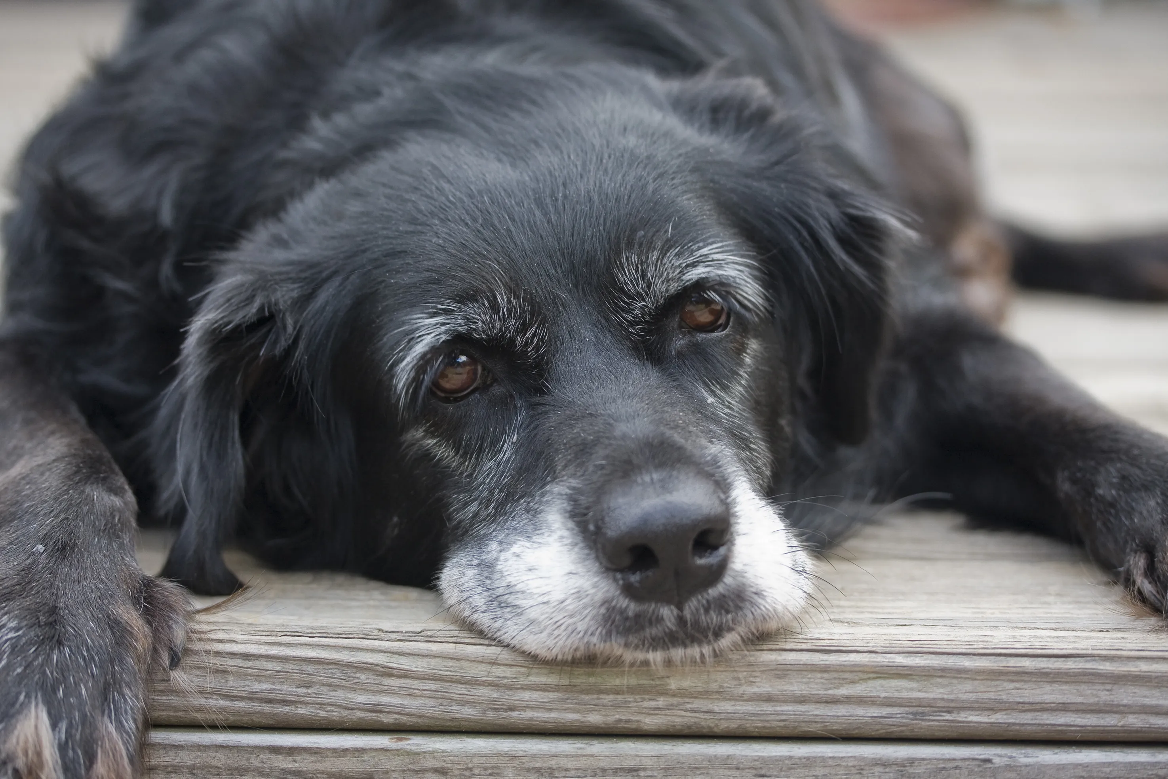
Notes:
What is the oldest animal you can think of? Any animal at all?

Slide 6
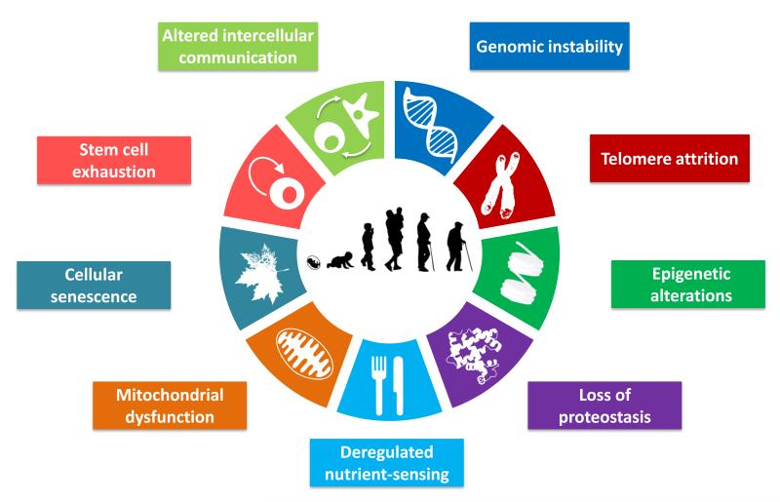
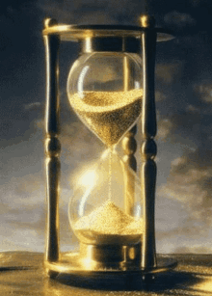

Slide 7
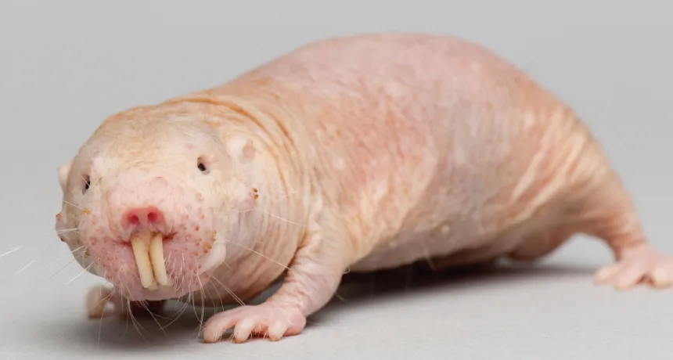
Notes:
This is a naked mole rat, how old do you think he can live for?
31 years, this is an insanely long time for a rodent.

Slide 8
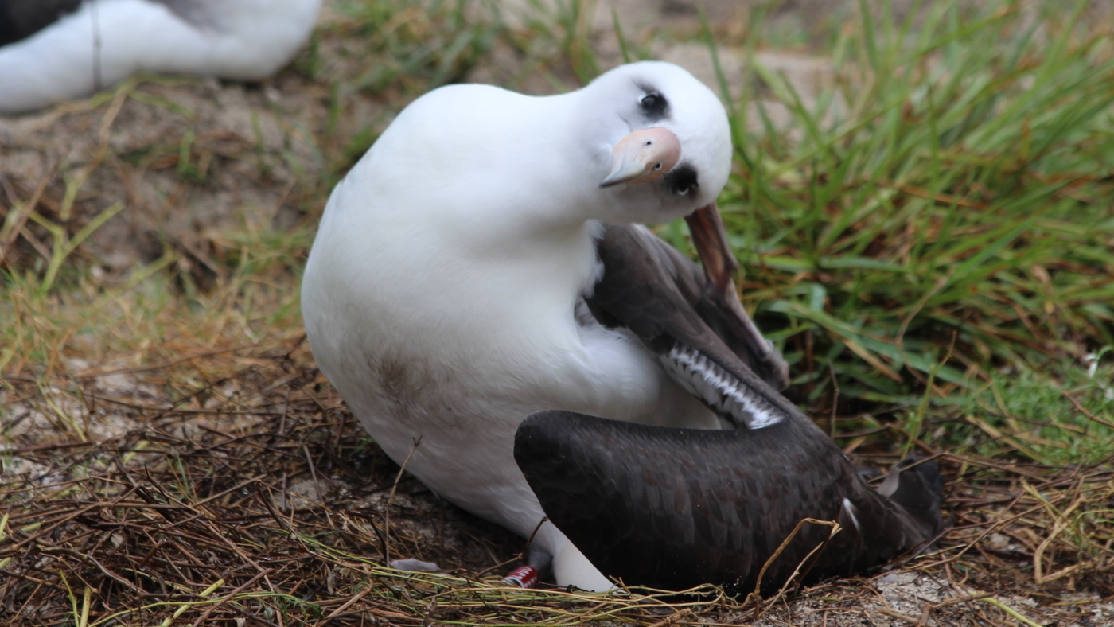
Notes:
This is a laysan albatross – any guesses on how long they can live?
This particular albatross is actually a famous bird called Wisdom, she is 74 years old and still laying eggs!

Slide 9
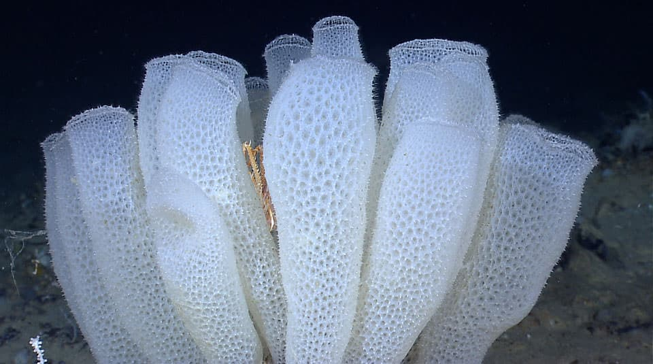
Notes:
Finally, here is a glass sponge, they live around Antartica. Anyone want to have a guess how long they live for?
…..these sponges are estimated to live 15,000 years!!!

Slide 10
Thank you!!
Please take 5 minutes to give us feedback! Write on the back of the sheet if you run out of room. We’d like any ideas on how to make it funner/more engaging and whether the difficulty was too hard or just right. ☺
Really well done, this was a difficult activity resembling a real world programming scenario with real data!

